Slide 1

BOTASTRA presents
Pitch-a-bot
Name: S MOHANA PRIYA
Problem Statement No. : 1B

Slide 2
THE PROBLEM STATEMENT
1B
In present-day India, Traffic jams are a major problem especially during the peak hours of work during the weekdays in major cities. On any intersection there are moments when the density of traffic on one or more lanes is light and the other lanes have a high density. A normal traffic signaling system is incapable of doing anything to optimize this condition, the result of this is traffic jams, fuel wastage and pollution. To counter this problem, with the use of sensors , you have to come up with an idea to reduce the traffic and maintain free flow of traffic especially during the peak hours. You should also try to make your solution as economical as possible.

Slide 3
UNDERSTANDING THE PROBLEM
01
Traffic congestion is caused mainly due to ever increasing on-road vehicles and infrastructural incapability and the conventional fixed time TSCs with predetermined cycle length, split setting plan add to problem by increasing the average delay time at the intersections because at any intersection there are moments when the density of traffic on one or more lanes is light and the other lanes have a high density. A normal traffic signaling system is incapable of doing anything to optimize this condition, the result of this is traffic jams .
02
To optimize the situation i.e. reduce the waiting period and manage the queue length, some of the TST setting parameters should be able to adapt to the fluctuations in traffic demand based on inputs from different sensors.

Slide 4
Idea and Approach
The number of stopped vehicles and the delay can be reduced by increasing the green phase timing for a particular movement. However, an increase in the green time of one traffic movement usually occurs at the expense of increased delay (and also maybe the number of stopped vehicles) in other movements. Sometimes there is no traffic in the other lane and still the waiting continues. Therefore, a good signal timing plan is one that allocates time so that overall traffic performance i.e. average wait delay time and queue length is optimized.
The basic approach is to get traffic density data of the lanes using the microwave radar sensor (RCWL-0516) and based on the traffic density allotting a green time of specified timing predetermined from various factors such as time required to cross an intersection for a vehicle.

Slide 5
Idea And Approach
Conventional traffic light uses fixed time which causes 2 main problems .One of them is heavy traffic jam and hence there is no realization on how to measure the level of congestion and to minimize the delay including the green time and the clearance time required for different traffic densities. Another major problem with conventional traffic lights is when there is no traffic, but the waiting still continues
In order to resolve this problem, design of this traffic light will help to reduce traffic jammed at a particular location. This traffic light uses an Arduino UNO microcontroller to create an automation function together with a microwave radar sensor which is better than PIR or IR sensor for the temperatures in India to detect the density of the traffic and there is not much difference in cost.
The average time taken for a vehicle to cross an intersection depends on the following factors:
Its relative position from the intersection
how long it takes the driver to notice the light has turned green
how long it takes the driver to put the car in gear and start to accelerate

Slide 6
Idea And Approach
How far it is across the intersection
how fast they decide to accelerate
What vehicle they are driving
Using the data of the research paper “A Study of the Travel Time of Intersections by Vehicles using Computer Vision” by V. D. Shepelev, A. I. Glushkov , Z. V. Almetova and V. G. Mavrin https://www.scitepress.org/Papers/2020/98062/98062.pdf for the average time taken for a vehicle to cross the intersection the following conclusion has been made.
Assuming average of those values as being the average of the vehicle crossing time, it comes out to be 5.905 s per vehicle. Taking the average time intervals of 90 secs , 75 secs , 60 secs , 45 secs and 30 secs of green time and 5 sec of clearance time at each signal, the maximum wait time would be 285 secs. With the data assumed above and an average car length of 3m a traffic of about 45 to 50 m will be cleared at the minimum for a green time duration of 90 secs , for 75 sec it would result in clearing 40 m and 60 sec would lead to 30 m and for 45 secs it would be approximately 20m. The 30 secs is a buffer time for the lanes where the traffic isn’t detected within 50 m from the intersection to avoid any mishap.

Slide 7
COMPONENTS REQUIRED
Arduino Mega 2560
Breadboards
Jumper cables
Microwave radar sensors (RCWL -0516)
Red LEDs
Yellow LEDs
Green LEDs
220 ohm resistors
Molded polycarbonate.
The lamps used in traffic lights must be designed for long life and should be partially surrounded by polished metallic reflector which can direct the light forward.
The lens of every light is made of plastic or tinted glass while the visor (hood) is made of molded polycarbonate or aluminium.
SOFTWARE USED
Fritzing

Slide 8
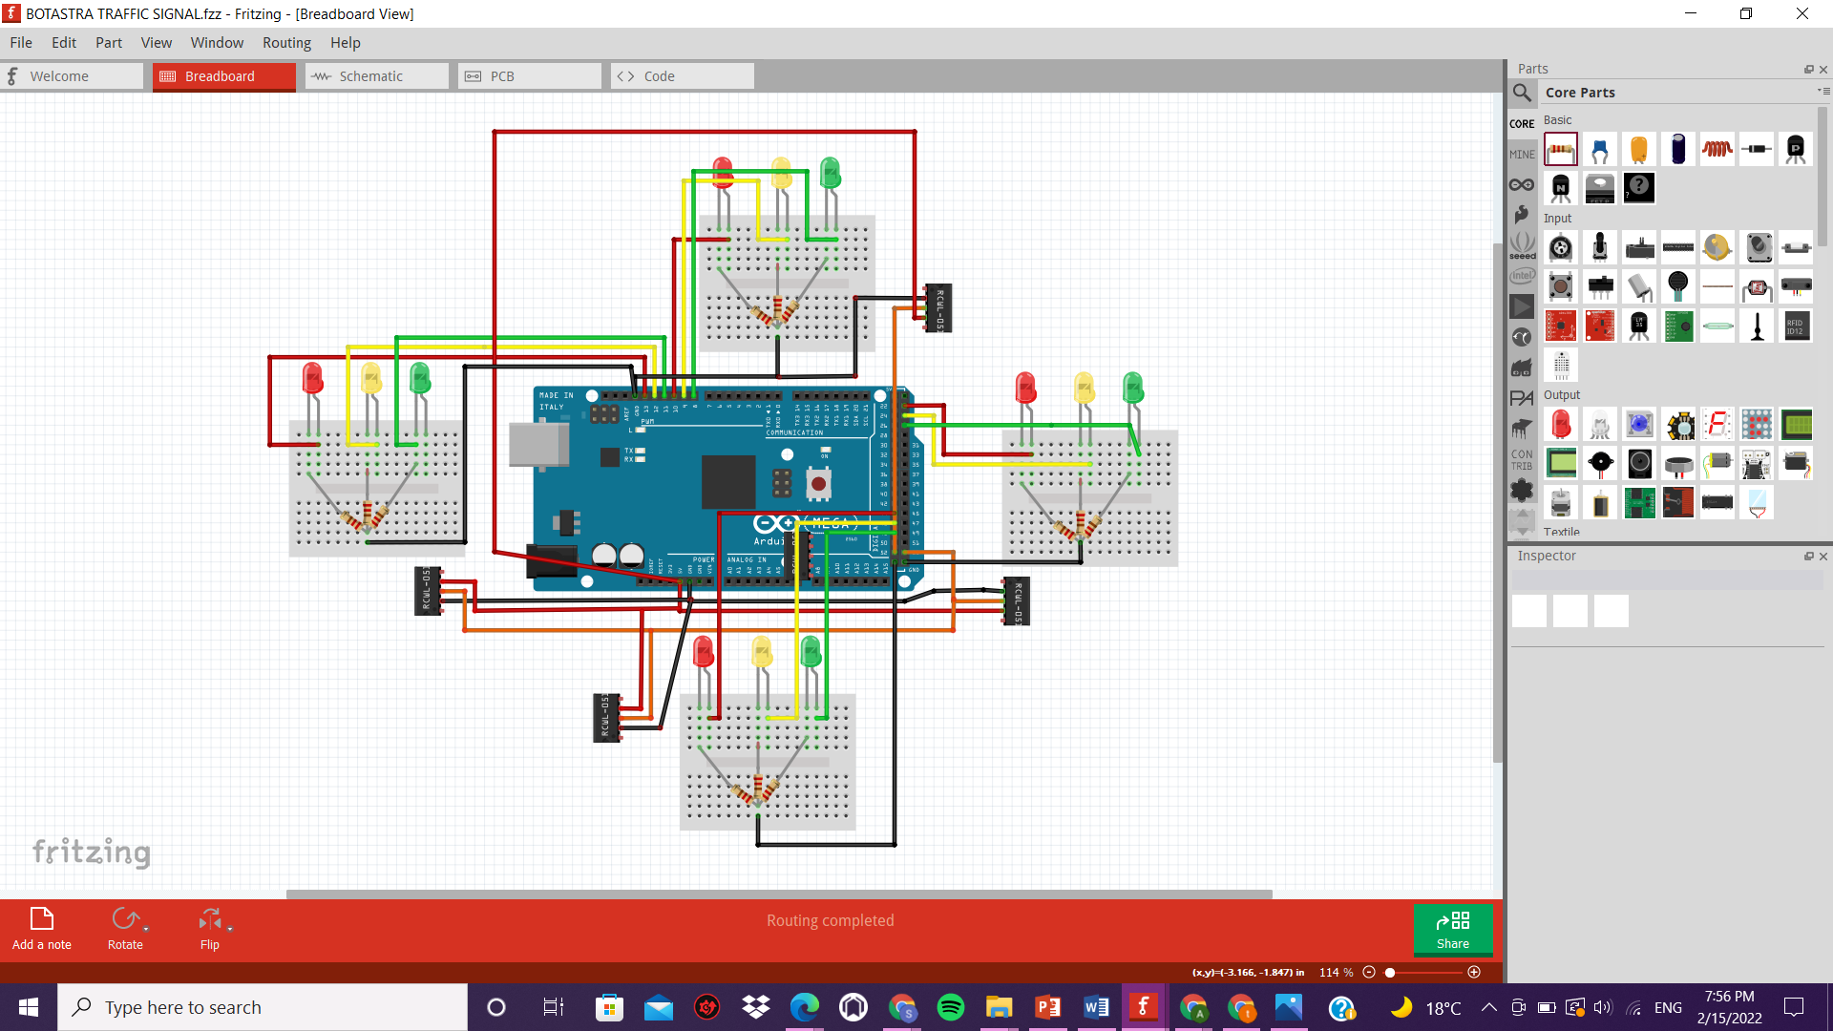
CONNECTION AND CIRCUIT DIAGRAM

Slide 9
PSEUDOCODE
The Arduino microcontroller will start from signal 1 :
Get the lane stats through RCWL - 0516 sensor.
If traffic >= 40m:
Green time = 90 sec + clearance = 5 sec
Switch to second lane
else if traffic >=30 m
Green time = 75 sec + clearance = 5 sec
Switch to second lane
else if traffic > 20 m
Green time = 60 sec + clearance = 5 sec
Switch to second lane
else if traffic > 10m
Switch to second lane
Green time = 45 secs + clearance = 5 sec
else
Green time = 30 secs
Switch to second lane
//This continues similarly for the other lanes.
#NOTE: The time intervals taken here are based on approximate values considering the research paper. It is clearly understood that the intersection is quite long to cross and the queue length of even 50 m means a large volume and no. of vehicles. Also the timing settings for a particular intersection will differ and above is only for the intersection under consideration.

Slide 10
PROBLEMS FACED Could not get the fritzing part module for RCWL-0516 microwave radar motion sensor to make the circuit diagram. There were not many research papers available on the time taken to cross an intersection at different hours and the traffic densities, there was only one available research data conducted in Russia which I used for the interval calculations.

Slide 11
TAKEAWAY AND RESOURCES
There were many papers and projects that involved the use of IR sensor to monitor the traffic volume and build an Arduino based time adaptive traffic signal control. All of these usually used 4 IR sensors. I chose microwave radar sensor because of it’s better reliability than the IR sensors at higher temperature. The microwave radar sensor uses Doppler’s effect to detect motion because of this it can have an overall coverage of the entire intersection, because of this I could not understand how many sensors we would need for an intersection as well as how to position them so that it detects only the traffic in a single lane.
I read online articles that microwave radar sensors were used to detect traffic, but could not get specifications related to the exact design.

Slide 12
TAKEAWAY AND RESOURCES
My main idea was to minimize the average delay by optimizing the green time and the clearance time based on AI models and thus creating a real time system but I could not understand the efficiency of such systems when the signals change at unexpected rates.

Slide 13
RESOURCES
IR based TSC and IR vs Microwave radar ttps://www.researchgate.net/publication/342268726_Density_Based_Traffic_System_via_IR_Sensor
https://greenlighting.co.uk/pir-vs-microwave-sensors-need/
https://rotech.com.au/microwave-vs-infrared-activation-sensors-whats-thedifference/#:~:text=Microwave%20sensors%20are%20highly%20sensitive,erroneously%20or%20trigger%20false%20alarms
https://www.martecaustralia.com.au/microwave-sensor-vs-pir-sensor/
FOR FRITZING NEW PART EDITOR:
https://www.youtube.com/watch?v=Lf0QgLRjuy0
https://www.youtube.com/watch?v=dfxx8wF3Uhs
RCWL -0516 datasheet
https://www.elprocus.com/rcwl0516-microwave-distance-sensor/
https://github.com/jdesbonnet/RCWL-0516

Slide 14
RESOURCES
MATERIALS REQUIRED:
http://www.madehow.com/Volume2/TrafficSignal.html#:~:text=The%20housing%20or%20body%20of,is%20designed%20for%20long%20life.
https://www.in.gov/dot/div/contracts/standards/rsp/mar05/913T137.pdf
RESEARCH PAPER :
https://www.scitepress.org/Papers/2020/98062/98062.pdf
Microwave Radar sensor connection:
https://dronebotworkshop.com/rcwl-0516-experiments/

Slide 15
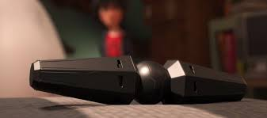
THANK YOU

